Slide 1
How to Predict prices in Ames, Iowa
By Shanell Jones
Data Scientist

Slide 2
Problem/why we are here
Problem that we are here to solve
What variables can we use to predict housing prices in Ames, Iowa
Agenda
How I cleaned data
How I chose features
How I chose to add additional variables
How I chose interaction variables
How I chose my final model
Data Sources
Ames Iowa Sales Data for 2014

Slide 3
Introduction to Modeling Selection
Worst Scoring model
Based on the mean of the training set sale price sale price
Slightly Better Scoring Model
Based on one categorical variable
Slight Improvement on Models
Inclusion of more independent variables based on numeric categorical variables to give context to other
Good Model
Combination of variables to change the dummy variables type of the variable
Great Model
Based on the dummy and interaction variables to change orientation of other variables
Best Model
Change to the y that allows for a log transformation
Variable Types
Categorical Variables-Ratings, Descriptions
Numeric Variables-Numeric Space, Number of Rooms

Slide 4
How We cleaned Data
Null Values
Null values were originally assigned to a blank value
This caused a problem due to lack of measurement
These were zeroed out die to limited information throughout the category
Incorrect data types
Numerous columns that were numeric registered as object
Functions were used to change these to strings
Outliers
Due low data these were kept in for the essence of time
Missing Columns
Columns were not present in the test data set that were present in training set
These were added as Nan values

Slide 5
Insights and how we Chose variable
How I found correlated values
Used a combination of a correlation matrix and a heat map
Chose values with strong correlation
Later used this information to combine like
How I engineered my first feature
Choose to Add context with a ratings matrix
Used this to add context to actual features
What I found when I did this
There is more explanatory power in the quality of how a house is built and or maintained then the presence of additional feature
Example is fireplace quality had a .2 and kitchen quality had a .4 while the number present was insignificant

Slide 6
Ratings Matrix
Rating Written Info | Numeric Conversion
NA/ Not Included | 0
Po/ Poor Quality | 1
Fa/ Fair Quality | 2
Ta/ Typical or Normal Quality | 3
Gd/ Good Quality | 4
Ex/ Excellent Quality | 5

Slide 7
What we found with our first Model
First model info
Linear Regression based on beds, baths, sqft, misc values like porches and numeric ratings
How variables were chosen
Variables were chosen via there correlation to the list price
Chosen for a strong positive or negative correlation above the absolute value of 0.20
Findings
Certain variables were shown

Slide 8
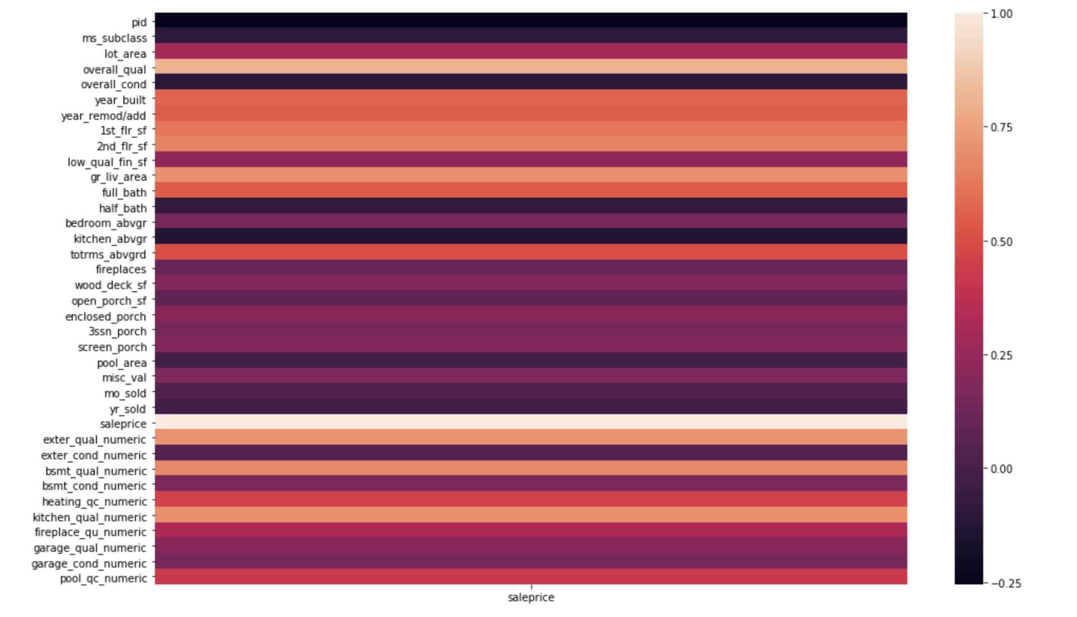
Heat Map Used to Choose Variables In First Two Models

Slide 9
What we found with our Second Model
How features have been dummied
Features attempted were attempted
Neighborhood, basement type, zoning, building type
Features that were ultimately chosen
House type, Sale type
Which Columns were drop for reference columns
Both variables were dropped in comparison to how little values there were
This were dropped due to the lowest number of occurrence within the dataset.
Which features were found to be the most important
These were combined into the model to show how the presence of house sale and house
Largest impact is shown when looking at New constructed building sales and two story homes

Slide 10
What we found with our Third Model
How Features were created
What Transformations were done on the variables
Both variables were dropped in comparison to how little values there were
How did this Change Variable behaviors
These numeric variables to be affected by categorical
Example is to allow bed, bathrooms, house ratings to affect sq ft
Variables showed a significant impact on correlation when combined together
How did this affect the model
Found to have greater explanatory power in order to explain most pricing
Much less homodestacity than originally inferred

Slide 11
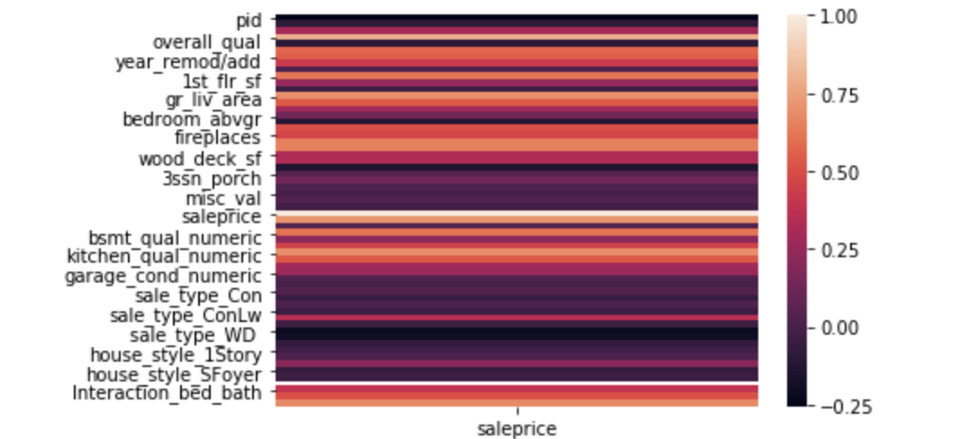
Heat Map Used to Choose Variables In Last Two Models

Slide 12
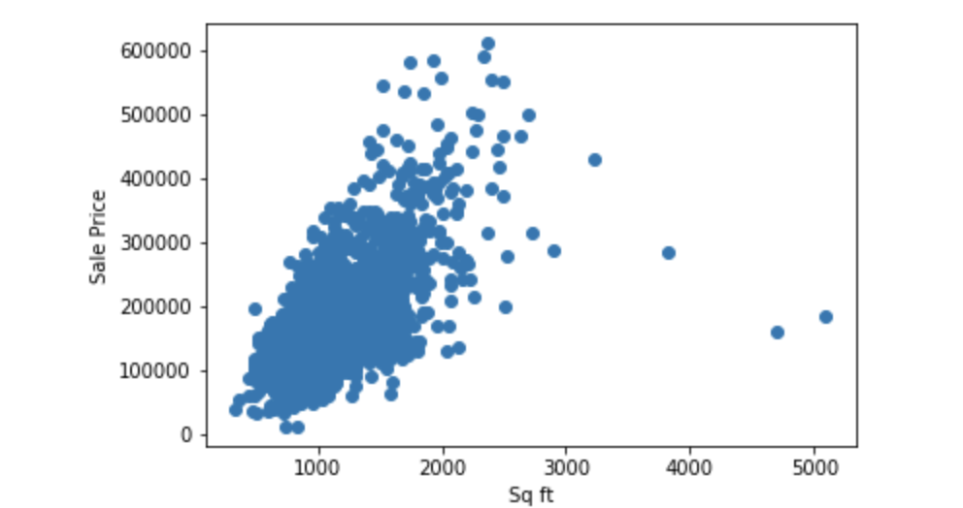
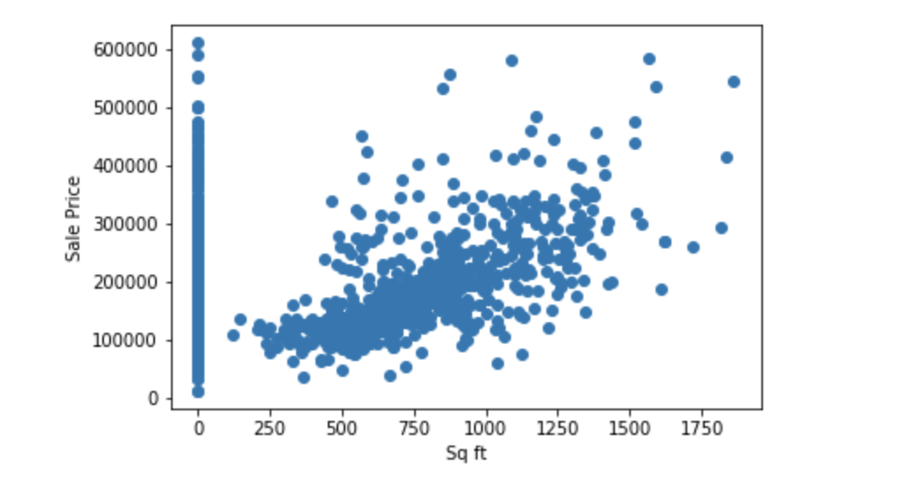
1st Floor Scatter Plot
2nd Floor Scatter Plot

Slide 13
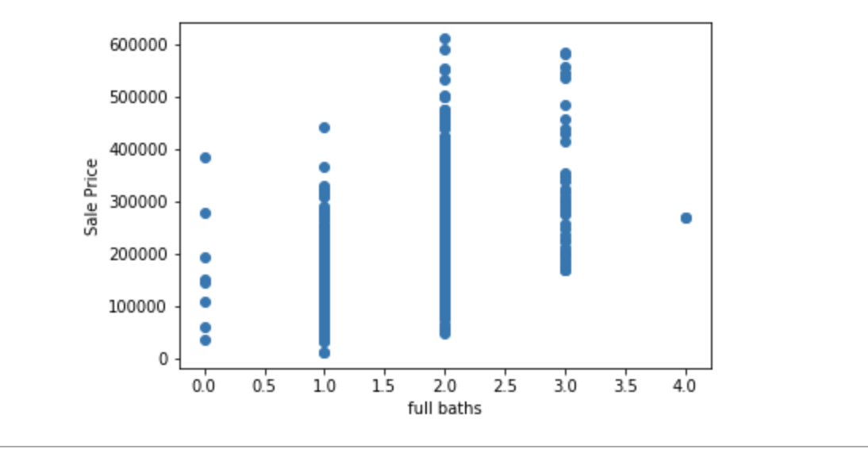
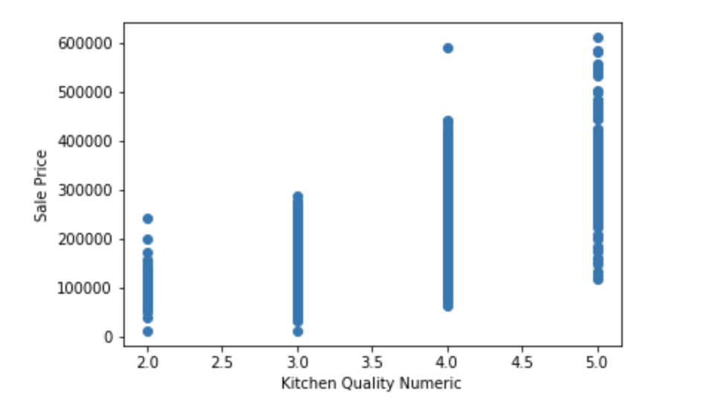
Number of Full bathrooms In House
Kitchen Rating

Slide 14
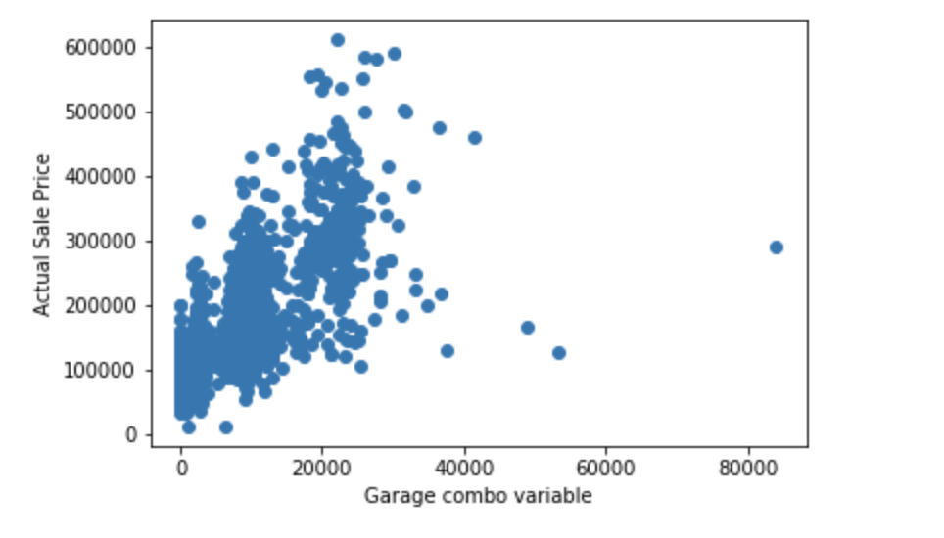
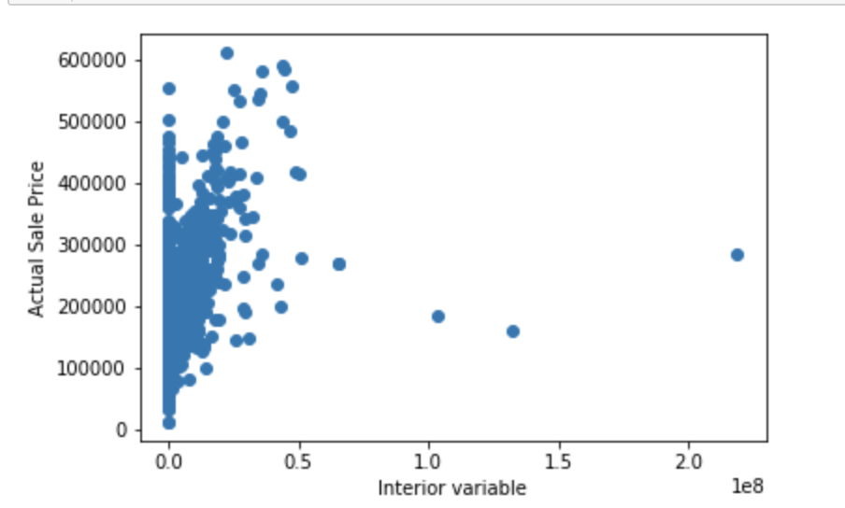
Garage Interaction
Interior Values

Slide 15
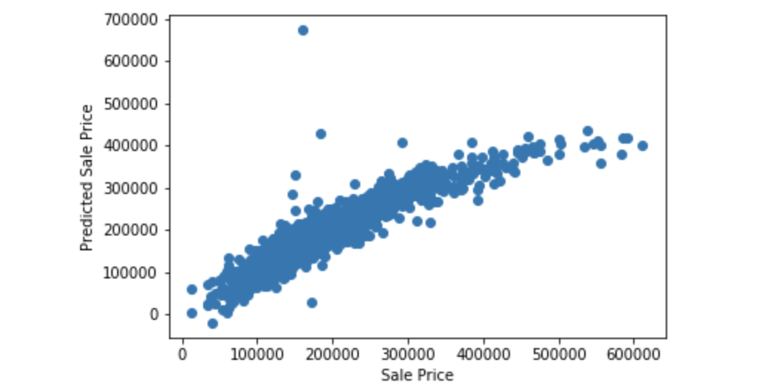
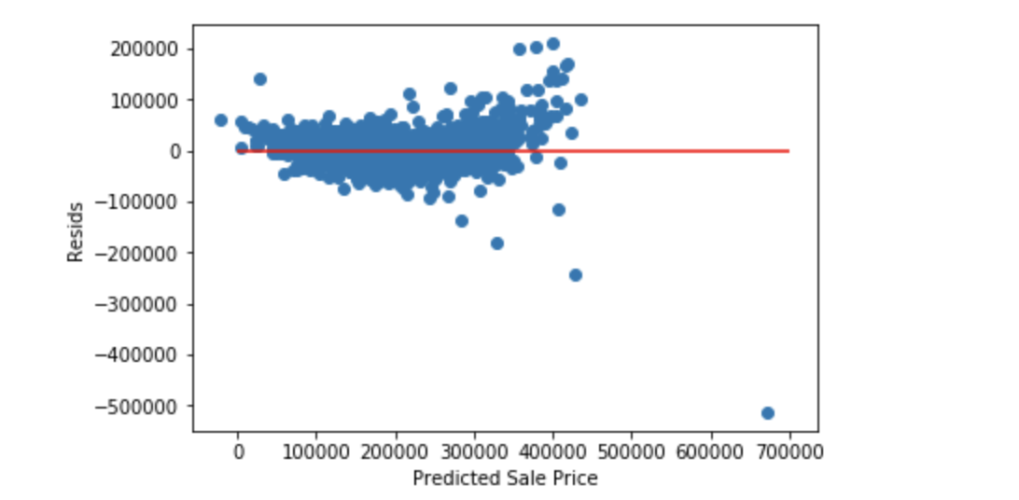
Linear Sale Price
Linear Residual Comparison

Slide 16
What we found with our Forth and Final Model
Changes were to the model
Model appears to have a trouble predicting higher sales values
Model appears to have a y=(x)^1/2 behavior
Fits a more natural log behavior
Evaluations that were made to the scaling data
Y is transformed into a natural log to ensure behavior of the model
Model was rescored with both in mind
Final submissions were based on the natural log
Model behavior changed to a more traditional linear distribution
Behavior between error and predicted values shows understandable homoscedastic behavior
Final model is scored with a r^2 of 0.87 to 0.88
When Lassoed r2 was within 5% of that score showing that the model has a good tradeoff between bias and variance
When checking coefficients all, but two had value to the model

Slide 17
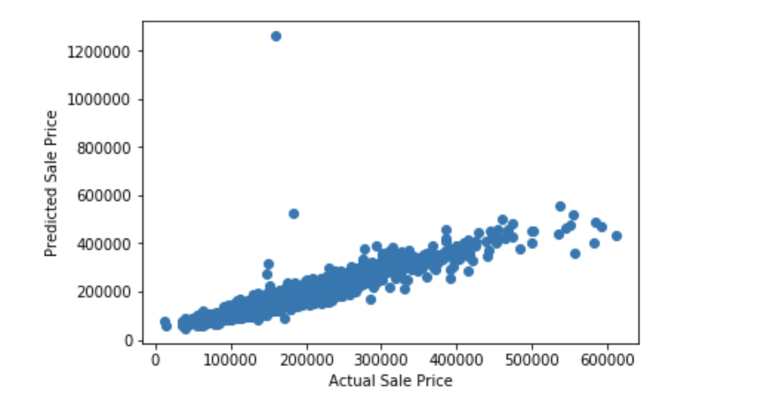
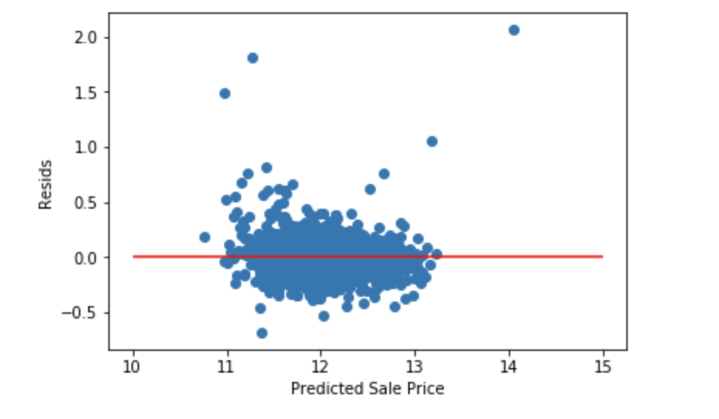
Linear Sale Price
Linear Residual Comparison

Slide 18
Conclusions and
Conclusions
Price is based a log equation of ratings, important room info, quality, neighborhood and house type info
Further Research and Recommendations
Further Research is needed in the following categories:
Neighborhood info like historic neighborhood and schools
Transactional information about previous sale
Town economic information-typically income, age demographic information, etc.

